Slide 1




Connect your favorite device & apps
Personify Health’s health and wellbeing program works with the best fitness tracking devices and mobile apps in the market. Take a look at the brands we’ve partnered with to help you be successful and have fun getting healthier!
Don’t have a Max Buzz fitness tracker? No problem. See real-time activity tracked by your Fitbit, Garmin, Apple Watch, Misfit, or Polar fitness trackers — right in the Personify Health app.
Don’t have the Personify Health app?
Download it today from the App Store or on Google Play
CLIENT LOGO

Slide 2

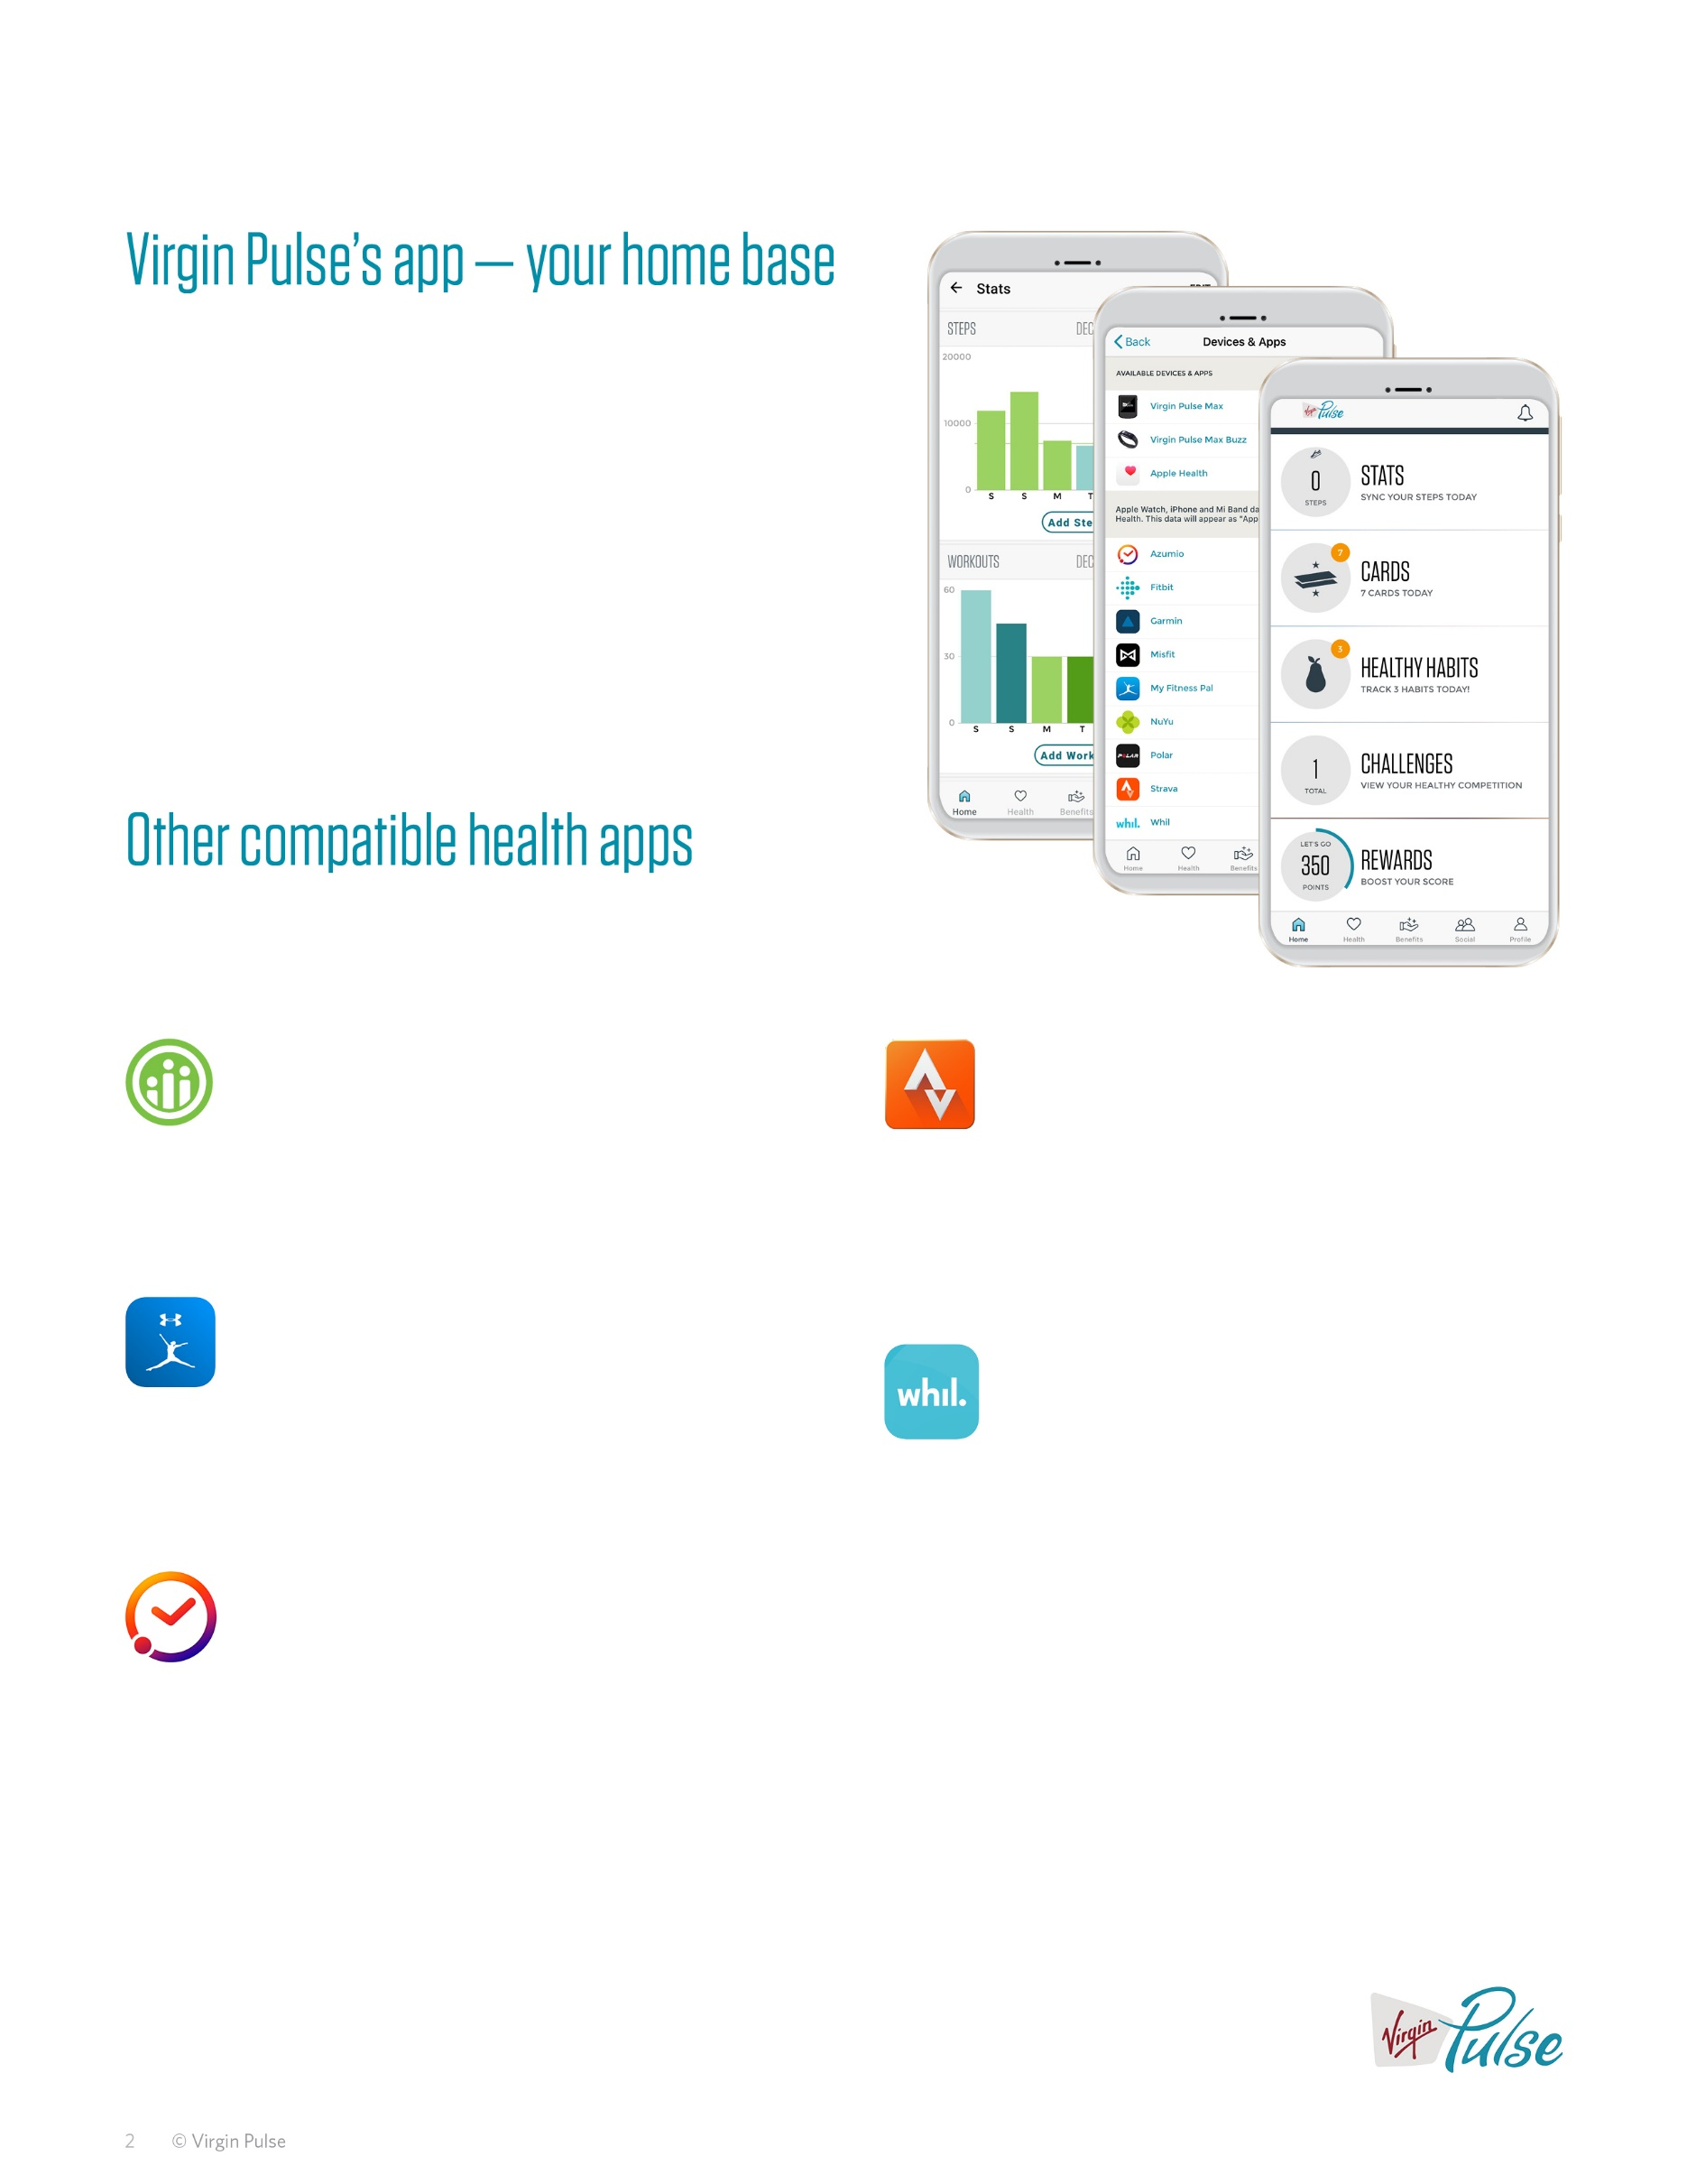
Personify Health’s app – your home base
If you haven’t downloaded our mobile app, what are you waiting for? The app is one of the best ways to get involved in your company’s wellbeing program. Go to the App Store or Google Play to download the app and access the same, great website features while on the go. Whether you’re at home, in the office, or at the gym, you’ll easily find everything you need to get healthier, compete with coworkers, and challenge yourself.
Other compatible health apps
Do even more by connecting the health and wellbeing mobile app you already know and love.
Higi
Strava
Visit a Higi health station to know your numbers and keep track of them in Personify Health’s program.
Strava uses GPS to track activities like cycling and running. Easily connect your Strava account to Personify Health, and see your activity in the Get a Workout tracker and on your Stats page.
MyFitnessPal
Whil
MyFitnessPal is a free app and website that lets you track the foods you eat.
Breathe in, breathe out. Mindfulness is a big part of your total health and wellbeing. Connect Whil’s app to watch meditation videos, yoga tutorials, and more!
Sleep Time by Azumio
Sleep Time provides insight into your sleep patterns. By tracking your level of movement throughout the night, Sleep Time generates customized sleep data in easy-to-read charts.

Slide 3
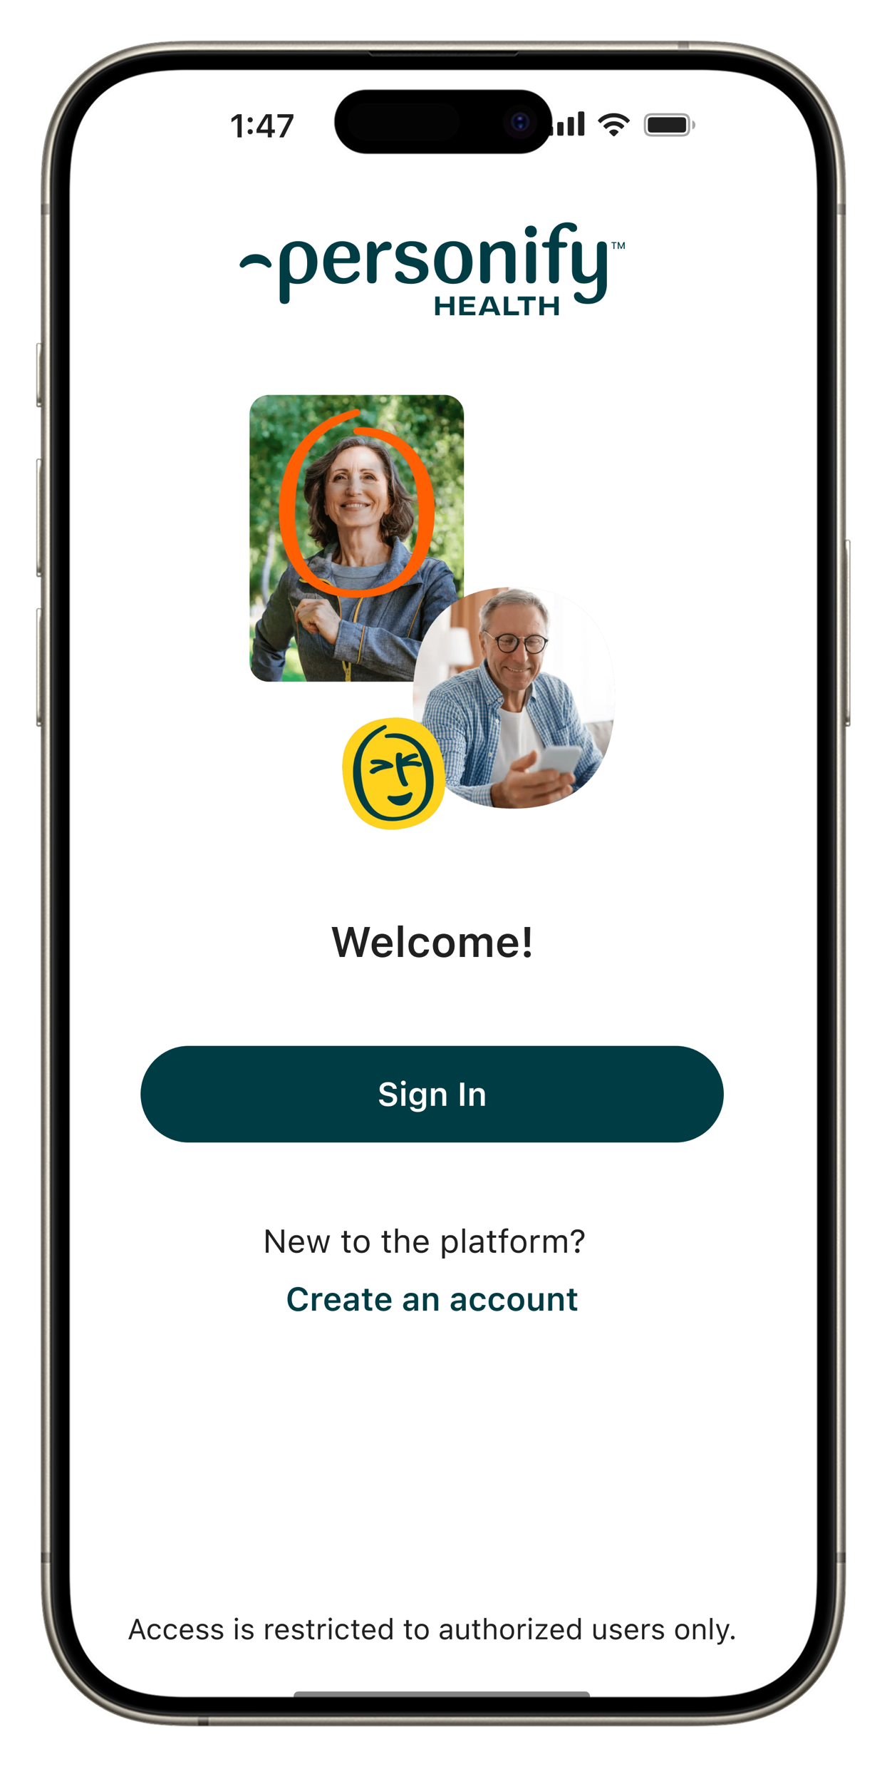

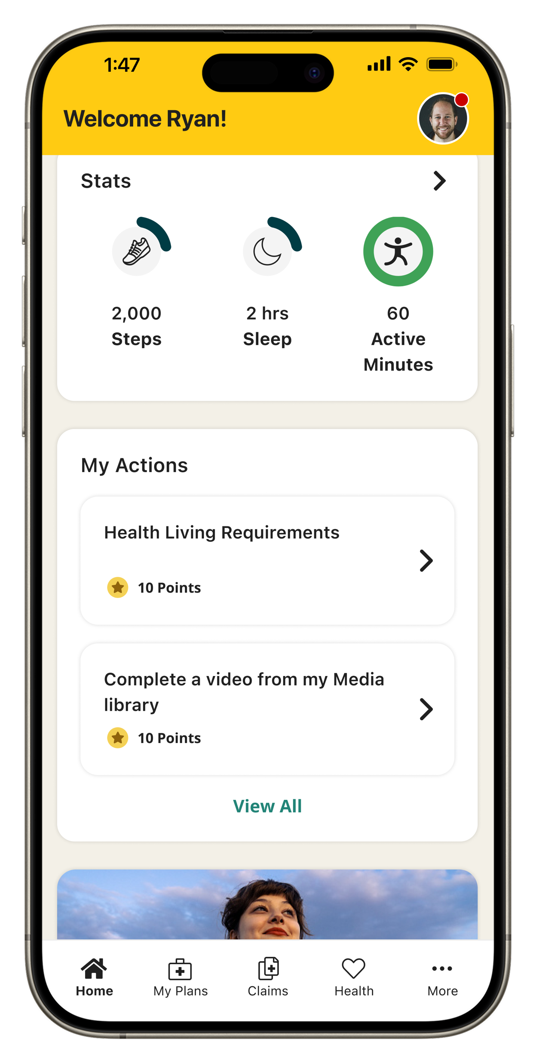

How to
connect apps
Step 1
Download the Personify Health mobile app from the App Store or Google Play.
Step 2
Go to Profile in the menu and choose Devices & Apps.
Step 3
Choose an app and click “Connect.”
Step 4
Sign in or get connected automatically (depending on the app).
Get started today Sign up for your wellbeing program at join.personifyhealth.com/COMPANY
© Personify Health 2024. All rights reserved.• PAGE 3

