Slide 1
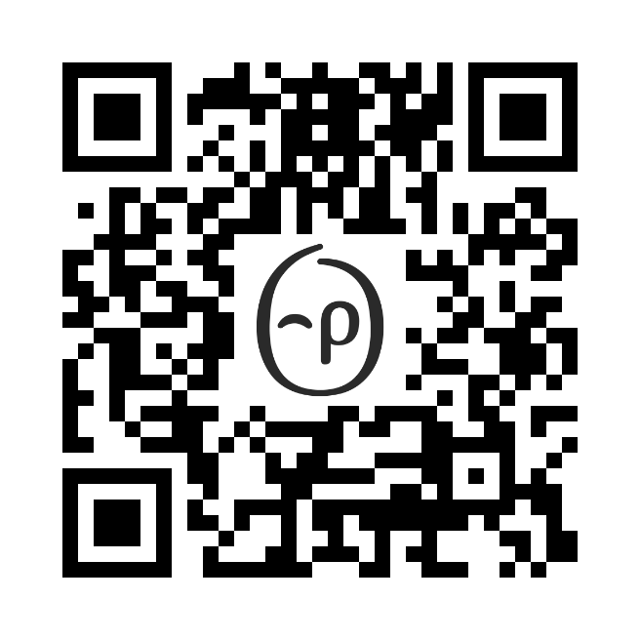
Earn
[XXX] points when you complete a Journey.
Journeys
®
Choose your path to better wellbeing.
When it comes to improving your health, small steps can lead to big things. With Journeys, you’ll get small, achievable steps that allow you to “try on” and build healthy habits that stick.
Whether you’re looking to improve your eating habits, move more, sleep better or manage a health condition, our digital coaching tool can help, and is just a click away.
Visit app.personifyhealth.com, go to the Health tab and select Journeys, or scan the QR code to open in the app.
Not a member yet?
Don’t miss out on all the fun! Get started today by going to
[join.personifyhealth.com/companyname].
Client Logo

Slide 2
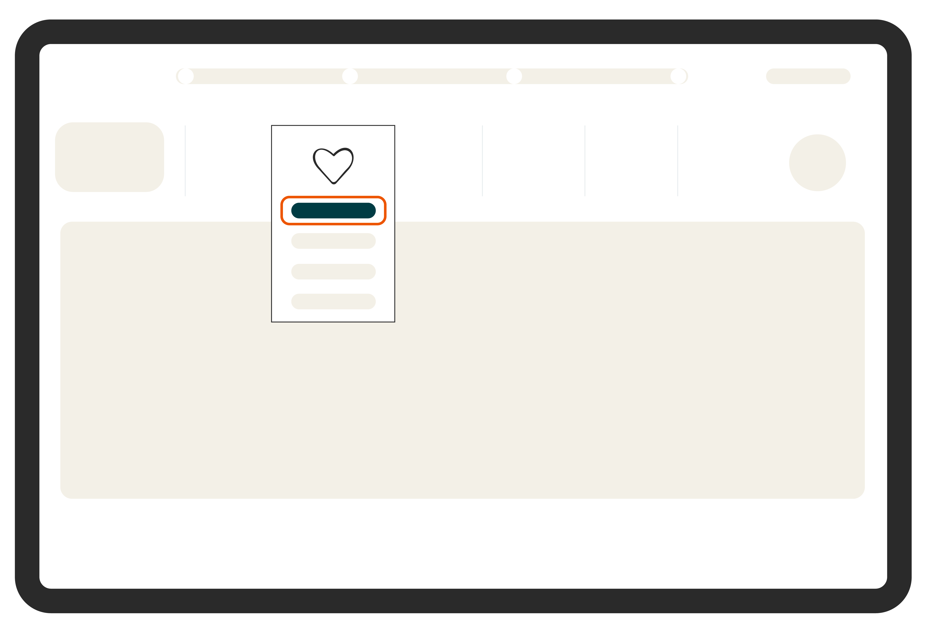
How to get started:
Step 1
Open the Personify Health mobile app or go to the website and find Journeys in the Health menu.
Step 2
Find the Journey that’s right for you. If you would like to view all the available Journeys in a topic, click View All.
Step 3
Click on the Journey you would like to learn more about. Click Start to begin your Journey.
Do you have a new health concern that impacts your daily wellbeing? Journeys can help you manage:
Journeys can help you:
Quit smoking
Reduce stress
Strengthen your financial fitness
Embrace diversity, equity and inclusion
Cope with grief and loss
Reduce your alcohol and/or tobacco consumption
Heart Health
Lung Health
Mental Health
Women’s Health
Back, Muscle & Joint Health
Have questions? We’re here to help.
• Check out support.personifyhealth.com Live chat: Monday–Friday, 2 am–9 pm ET
• Give us a call: 888-671-9395 Monday–Friday, 8 am–9 pm ET
• Send us an email: support@personifyhealth.com
© Personify Health 2025
0724

