Slide 1
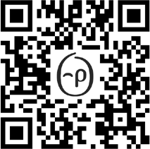
Top of Mindfulness
CLIENT LOGO
Ready to manage your stress?
Breathe deeply, slow down and be present in the moment. In this challenge, you’ll learn about
mindfulness and how to practise it every day. Set your personal goal, track your mindful minutes, restore composure to your life – and earn rewards.
Registration opens: XX Month
Sign in at app.personifyhealth.com and go to Social > Challenges, or scan the QR code to open in the app.
The challenge runs: XX-XX Month

